Slide 1

IBM Decision Optimization
Prescribes the best course of action when making complex decisions
ANALYZE
Build and scale AI with
trust & transparency by
Automating AI lifecycles
One Platform, Any Cloud
Notes:
There is no wand to be waved at enterprise inefficiencies, and having the technology alone is not enough. That is why the ladder, every step, is so critical. AI adoption necessitates a thoughtful and well-architected approach. For example, the vast majority of AI failures are because of data preparation and organization, not the AI models or use cases themselves. AI breakthroughs will come with mass experimentation. While many of those experiments will fail, the successful ones will have substantial impact. However, there are three major challenges organizations must overcome to truly transform into an AI-first company.
This is our prescriptive approach to helping clients accelerate their journey to AI which connects their data and AI capabilities within a unified data and AI lifecycle (or platform). This is also a way to help our clients identify where they are and where to focus based upon their maturity on the journey to AI. Furthermore, it is an organizing construct to the Data and AI products and services offered by IBM and our business partners, and it is the technology foundation to unify how those products and services work together.
What we have learned from AI pioneers is that every step of the ladder is critical. AI is not magic and requires a thoughtful and well-architected approach. For example, the vast majority of AI failures are due to data preparation and organization, not the AI models themselves. Success with AI models is dependent on achieving success first with how you COLLECT and ORGANIZE data.
Therefore, we believe clients must:
COLLECT -- Establish a strong foundation of data, making it simple and accessible, regardless where that data resides. Since data used in AI is often very dynamic and fluid with ever-expanding sources, virtualizing how data is collected is critical for clients.
ORGANIZE – Create a trusted, business-ready analytics foundation that ensures your data is ready for AI. Just because you can access your data doesn’t mean that it’s prepared for AI use cases. Bad data is paralyzing to AI. So clients must integrate, cleanse, catalog, and govern the full lifecycle of their AI data.
ANALYZE – Once your data is accessible and AI-ready, then you are better prepared to apply advanced analytics and AI models. This rung provides the business and planning analytics capabilities that are key for success with AI. It also provides the capabilities needed to build, deploy, and manage AI models within an integrated portfolio of technology.
INFUSE – Many businesses create highly useful AI models but then encounter challenges in operationalizing them to attain broader business value. This rung of the ladder infuses AI to achieve trust and transparency in model-recommended decisions, decision explainability, bias detection, decision audits, etc. For clients with common use cases, the INFUSE rung operationalizes those AI use cases with pre-built application services, speeding time to value.
MODERNIZE – Given the dynamic nature of AI, your data estate needs a highly elastic and extensible multi-cloud infrastructure to unify the aforementioned capabilities within a fully governed team-platform. Clients are also looking to automate their AI lifecycles across an array of contributors through collaborative workflows. Essentially, MODERNIZE means building an information architecture for AI that provides choice and flexibility across your enterprise. As clients modernize their data estates for an AI and multicloud world, they will find that there is less "assembly required" in expanding the impact of AI across the organization.

Slide 2
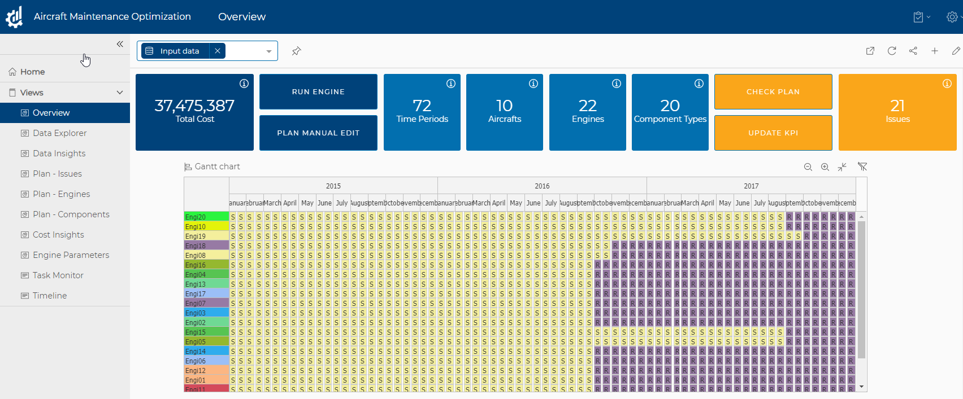
IBM Decision Optimization (CPLEX)
Advanced Decision Making for Complex Business Problems.
Applications include: Supply Chain, Production Planning & Scheduling, Revenue Management, Portfolio optimization, Workforce Management… etc
Core Technology
Products
Possibilities and Innovation
Stand alone
Model and Solve complex decision problems
Constant innovation to be the industry leading Optimization solver for over 30 years
Build anywhere, deploy anywhere with containers
Natural Language based modelling assistant
ML + DO for complete datascience solution
Build business applications with DOC or connect with Planning Analytics or build custom solutions
CPLEX Optimization Studio (Developer)
CPLEX Optimizer and CPLEX Server (Deployment)
Solver Engine
CPLEX: for LP, MIP, MIQCP
CP (Constraint Programming): Faster solver for Scheduling Problems
Decision Optimization Center (DOC)
Solution building platform
Modeling Language and API
OPL (Optimization Programming Language)
Modeling APIs: Python, C, C#, JAVA
With IBM Datascience Platform
On-Prem
Cloud
DO for Watson Studio (WS)
(available in WS Premium cartridge for CP4D)
Dev and deployment
DO for Watson Studio (WS)
(development)
DO for Watson Machine Learning Server (WML server)
Deployment
Roadmap item
Decision Optimization (DO) for Watson Machine Learning (WML)
(deployment service)
Sample DOC application

Slide 3

Product update
CPLEX Optimization Studio

Slide 4
How many optimization engine ?
2 engines
CPLEX – Mathematical Programming
Linear Programming
Mixed Integer Programming (most common)
Quadratic Programming
CP optimizer - Constraint Programming Optimizer

Slide 5
2 Fundamental Technologies
Mathematical Programming (MP)
CPLEX –The “Gold Standard” for LP & MIP in the Operations Research profession, because of superior:
Performance – can solve large MIP problems quickly t problems are MIP
Robustness – dependable, accurate, consistent
Interactive – able to stop and start at any point, able to force solutions, provide sensitivity information, analyze causes of infeasibility, etc
Founders received 1st INFORMS Impact Award in 2004
Constraint Programming (CP)
The first commercial tools for handling the toughest scheduling & routing problems
Temporal and non-linear constraints
Dealing with the high end of the “combinatorial explosion” problem
Excels at finding feasible solutions, then making incremental improvements
Latest, ILOG CP Optimizer, the first automatic constraint programming (CP) optimizer

Slide 6
Algorithms for Mathematical Programming
Simplex
Primal
Dual
Network
Barrier
Dynamic Search, Branch-and-bound (or, branch-and-cut)
Note: There are also algorithms for nonlinear programming, semi-definite programming, etc., that we are not covering here
LP/QP
LP/QP
Network LP/QP
LP/QP/QCP
MILP, MIQP, MIQCP

Slide 7
Selecting Best Algorithm
When | Use this Algorithm
You need a generically good solution and no special condition are present | Primal Simplex
The number of constraints exceeds the number of variables | Dual Simplex
You are modeling a network | Network Simplex
Problem size is large and thousands of variables | Barrier (this is very memory intensive)
The model is sparse and takes a long time to run
The problem has large aspect ratio and you expect most of the variables to stay on the lower bound | Sifting

Slide 8
A typical optimization model development cycle
The following tasks are part of the cycle:
Define the scope of the problem in business terms.
Identify the objective(s), decision variables and constraints.
Construct the mathematical optimization model.
Gather data to populate the model.
Create and test a prototype with a small data set.
Edit the model if required, based on the test results.
Create and test a complete instance of the model.
Evaluate performance and adjust the model as needed.
Develop advanced solution techniques, if required.
Notes:
Notes:
A typical optimization model development cycle starts with the scope definition, in business terms. Next, the OR analyst uses the scoping document to identify the objectives, decision variables and constraints, in order to construct a mathematical optimization model. The OR analyst will also gather data to populate the model, and then create and test a prototype with a small data set. The model is then edited as required, based on the test results. Next, the OR analysts creates and tests a complete instance of the model, and evaluates the performance. The model is adjusted as needed, and advanced solution techniques developed, if required in order to find a good solution in reasonable time.

Slide 9
The objective function
The objective function of an optimization model is a mathematical representation of the business objectives or goals to be achieved. Objective functions always start with the words “maximize” or “minimize”, and can be either a simple expression involving a single business objective, or a more complex expression combining several business objectives.
Some examples of objectives are:
Maximize profit
Minimize cost
Minimize tardiness
Maximize customer service
Maximize utility;
Maximize turnover;
Maximize return on investment;
Maximize net present value;
Maximize number of employees;
Minimize number of employees;
Minimize redundancy;
Maximize probability of survival;
Maximize robustness of operating plan.
Notes:
Notes:
The objective function of an optimization model is a mathematical representation of the business objectives or goals to be achieved. Objective functions always start with the words “maximize” or “minimize”, and can be either a simple expression involving a single business objective, or a more complex expression combining several business objectives. Some examples of objectives are to maximize profit, minimize cost, minimize tardiness, and maximize customer service. Take a minute to think what some of the objectives you'd like to optimize in your business are.

Slide 10
Decision variables (1 of 2)
Decision variables in an optimization model represent values or decisions that can be changed by the solver engine in order to arrive at the best possible value of the objective function.
Examples of decision variables are:
How much of a given product to produce
How many people to hire for a given task
Which location to choose for a new warehouse
What should be the start time of a given task
Notes:
Notes:
Decision variables in an optimization model represent values or decisions that are determined by the solver engine in order to arrive at the best possible value of the objective function. Examples of decision variables are how much of a given product to produce, how many people to hire for a given task, which location to choose for a new warehouse, and the start time of a given task. Take a minute to think of some decision variables that could influence the objectives you thought of earlier.

Slide 11
Decision variables (2 of 2)
Some characteristics of decision variables are:
Their value is determined during the solution process
They are initially unknown in a model, although it's possible to provide an initial guess to help the optimization
Decision variables have a domain: the set of all possible values for the variable
Decision variables have bounds: the lower and upper limits of the domain (infinite bounds are allowed)
Decision variables have a type, for example real, integer, or binary
Examples of variable types
Should a factory be opened in Detroit or not (yes/no decision: binary variable)
How many aircraft of type Boeing 767 to buy (integer variable: cannot buy half of an aircraft)
How much oil to produce during week 36 of year 2013 (real variable)
It is important to choose the decision variables well, because they impact the formulation of the constraints and the solution method used.
Notes:
Notes:
The value of a decision variable is determined during the solution process, and is initially unknown in a model, although it's possible to provide an initial guess to help the optimization engine. Decision variables have a domain, which defines the set of all possible values for the variable. Decision variables have bounds, which define the lower and upper limits of the domain. Note that infinite bounds are allowed. Decision variables have a type, for example float, integer, Boolean, or interval. The interval decision variable type is only available for CP Optimizer. It is important to choose the decision variables well, because they impact the formulation of the constraints and the solution method used. For example, LPs may only use real variables, whereas IPs or MIPs allow integer variables.
The word “variable” alone, when used in an MP or CP context, refers to a decision variable. Note that this is different from a script variable (used in IBM ILOG Script) or a data element that represents data in an OPL model.

Slide 12
Constraints
Constraints define the relationships between different decision variables and also relate the data to the decision variables. They represent the limits within which the solution should exist.
Examples of constraints are:
The amount produced of a given product should be less than the production capacity
The people hired for a given task should have a minimum set of skills
The total cost of building a new warehouse should be less than the budgeted amount
The output from a process should equal the yield multiplied by the input
A certain task can only be started once a related task has been completed
Notes:
Notes:
Constraints define the relationships between different decision variables and also relate the data to the decision variables. They represent the limits within which the solution should exist.
Examples of constraints are that the amount produced of a given product should be less than the production capacity, that the people hired for a given task should have a minimum set of skills, that the total cost of building a new warehouse should be less than the budgeted amount, that the output from a process should equal the yield multiplied by the input, and that a certain task can only be started once a related task has been completed.
Take a minute to think what some of the constraints that describe your business problem are.

Slide 13
Hard versus soft constraints
Constraints are either “hard” or “soft”.
Hard constraints should not be violated under any circumstances, for example a constraint on production capacity when no additional capacity is available by any means.
Soft constraints can be violated under certain circumstances, for example a constraint that requires production to exceed customer demand. Such a constraint may need to be violated if there is, for example, an unexpected surge in demand or an equipment failure.
In the case of soft constraints, a penalty is often added to the objective to minimize the constraint violation.
Notes:
Notes:
Constraints are either “hard” or “soft”. Hard constraints should not be violated under any circumstances, for example a constraint on production capacity when no additional capacity is available by any means. Soft constraints can be violated under certain circumstances, for example a constraint that requires production to exceed customer demand.
Such a constraint may need to be violated if there is, for example, an unexpected surge in demand or an equipment failure. In the case of soft constraints, a penalty is often added to the objective to minimize the constraint violation. Try and identify whether the constraints you mentioned for your business problem are hard or soft.

Slide 14
Mathematical programming
Mathematical programming techniques include:
Linear Programming (LP)
Integer Programming (IP)
Mixed-Integer Programming (MIP)
Quadratic Programming (QP)
Mixed-Integer Quadratic Programming (MIQP)
Several others, some of which are not currently offered in widely used software packages, for example Non-Linear Programming (NLP) in a broader sense (strictly speaking QP, which is offered by many vendors, is a subset of NLP).
The different techniques address different types of problem structures, with LP being the original and generally simplest of these.
MIP is most often used in real applications
Notes:
Notes:
Mathematical programming techniques include Linear Programming (or LP), Integer Programming (or IP), Mixed-Integer Programming (or MIP), Quadratic Programming (or QP), Mixed-Integer Quadratic Programming (or MIQP), and several others. Some techniques are not currently offered in the IBM ILOG product line, for example Non-Linear Programming (or NLP) in a broader sense. Strictly speaking QP is a subset of NLP, but still possible with CPLEX Studio. These different techniques address different types of problem structures, with LP being the original and generally simplest of the mathematical programming techniques.

Slide 15
The mathematics of Optimization
Tutorials
Linear Programming Tutorial notebook part 1.
Linear Programming Tutorial notebook part 2.
Scheduling Tutorial notebook

Slide 16
Modeling optimization problems

Slide 17
What Are Models?
A data-independent abstraction of a problem
Mathematical Programming modeling languages lets you write down the mathematical representation of a model separately from the data
Configuration
Model
Data
One
Problem
Instance
Notes:
When solving an optimization problem, you want to represent the decisions, constraints, and objective without including specific data values. The model is data independent, and can be used to solve different problems with the same structure of the data.
OPL lets you keep data independent from the model, allowing you to use different data sets with the same model
A project is a collection of a model plus one data set. When you put them together, you get a single problem instance.

Slide 18
A Production Planning Example
A manufacturer wants to sell a product
The product can be made either
Inside the factory
Scarce resources are required to build the product
There is a cost per unit to manufacture the product
Outside the factory
There is a cost per unit to purchase the product
All demand must be satisfied
The goal is to minimize cost
Illustrate an example using the language OPL (Optimization Programming Language)
Notes:
Let's illustrate this concept via an example from linear programming. We are manufacturing a product to sell and we can do some production inhouse, or buy the product from someone else and then sell what we buy. When we are inside the factory, we have limited resources to build the product. There is a cost per unit of manufacturing and a cost per unit of buying it from the outside.
We are required to meet the demand for the product, and our goal is to minimize cost.

Slide 19
Data Declarations
Sets of products and resources
setof(string) Products = ...;
setof(string) Resources = ...;
Number of units of each resource needed to produce one unit of each product
float consumption[Products][Resources] = ...;
Total number of available resources
float capacity[Resources] = ...;
Number of units in demand for each product
float demand[Products] = ...;
Cost per unit of inside and outside production
float insideCost[Products] = ...;
float outsideCost[Products] = ...;
Notes:
This slide uses animation for each bullet point.
To describe our problem, we need to first list the data for our problem.
(CLICK) First, we are given two sets, the set of products to produce and the set of resources needed to build the product within our plant. OPL code to declare this data is shown. OPL keywords are in red. The word "enum" indicates an enumerated set. The three dots indicate that the data lives in an external data file.
(CLICK) The next data item indicates how much of each resource is needed to produce one unit of each product. The declaration in OPL indicates that this data is floating point, must be non-negative. The two-dimensional array holding this data is indexed on the set of products and resources.
(CLICK) We are also given the number of units of each resource that are available.
(CLICK) And the number of units of demand for each product.
(CLICK) Finally, the cost data is given as single dimensional arrays, indexed on the set of products.

Slide 20
Products Could Be Jewelry
Products and Resources
Products = { rings earrings };
Resources = { gold diamonds };
Consumption
A ring requires 3 units of gold and 1 diamond
A set of earrings requires 2 units of gold and 2 diamonds
consumption = [ [3, 1], [2, 2] ];
Capacity (Available units of gold and diamonds)
capacity = [ 130, 180 ];
Demand (Number of rings and earrings)
demand = [ 100, 150 ];
Costs (per unit for rings and earrings)
insideCost = [ 250, 200 ];
outsideCost = [ 260, 270 ];
Notes:
This slide uses animation!
Now let’s take a look at some possible data sets for this problem. First, let's assume we are a jewelry manufacturer.
(CLICK) If we are making jewelry, our products are rings and earrings, and our resources are gold and diamonds.
(CLICK) The requirements for how to make one ring and one set of earrings are given, showing the amount of gold and diamonds needed.
(CLICK) The number of units of gold and diamonds are given.
(CLICK) The demand for each product is given.
(CLICK) The cost per unit of production is given.
Note that OPL allows you to declare the data in different ways. This is just one example.

Slide 21
Products Could Be Pasta
Products and Resources
Products = { kluski capellini fettucine };
Resources = { flour eggs };
Consumption
Kluski requires 0.5 units of flour and 0.2 eggs
Capellini requires 0.4 units of flour and 0.4 eggs
Fettucine requires 0.3 units of flour and 0.6 eggs
consumption = [ [0.5, 0.2], [0.4, 0.4], [0.3, 0.6] ];
Capacity (Available units of flour and eggs)
capacity = [20, 40];
Demand (Number of each pasta needed)
demand = [100, 200, 300];
Costs (per unit for each pasta)
insideCost = [0.6, 0.8, 0.3];
outsideCost = [0.8, 0.9, 0.4];
Notes:
This slide uses animation!
Now, let's assume we are a pasta manufacturer.
(CLICK) If we are making pasta, our products are kluski, capellini, and fettucine, and our resources are flour and eggs.
(CLICK) The requirements for how to make each kind of pasta are given, showing the amount of flour and eggs needed.
(CLICK) The number of units of flour and eggs are given.
(CLICK) The demand for each product is given.
(CLICK) The cost per unit of production is given.
We've now seen that in different industries, we can have the same problem to solve.

Slide 22
Problem Model Is Identical
setof(string) Products = ...;
setof(string) Resources = ...;
float consumption[Products][Resources] = ...;
float capacity[Resources] = ...;
float demand[Products] = ...;
float insideCost[Products] = ...;
float outsideCost[Products] = ...;
dvar float+ inside[Products];
dvar float+ outside[Products];
Data
Decision
Variables
Decisions can be fractional values
Notes:
This slide uses animation.
The problem model is identical.
(CLICK) We first declare our data as we showed on the previous slides.
(CLICK) We then declare our decision variables, which are the number of units of each product to produce inside the plant and outside the plant. Note the word "var" which is used to indicate that these are decision variables, and not data.

Slide 23
Problem Model Is Identical (2)
minimize
sum(p in Products)
(insideCost[p] * inside[p] +
outsideCost[p]* outside[p] );
subject to {
forall (r in Resources)
sum (p in Products)
consumption[p][r]*inside[p] <= capacity[r];
forall (p in Products)
inside[p] + outside[p] >= demand[p];
};
Objective Function
Constraints
No quadratic terms, so this is Linear Programming
Notes:
This slide uses animation.
Here is the linear programming model for this problem.
(CLICK) The objective function is to minimize costs. We need to sum over the set of products the cost of inside production, represented by multiplying the inside cost per unit times the number of units produced inside, plus the cost of outside production, represented by multiplying the outside cost per unit times the number of units purchased from outside. Note that OPL is allowing an easy expression to be written that expresses the sum over the set of products.
(CLICK). The constraints for our problem are then given in a "subject to" block. Each resource is limited by the capacity of that resource. For each resource, we write a constraint that computes how much of that resource is used inside the plant. This is determined by multiplying the consumption value times the inside production value, and summing over all the products. This sum must be less than the capacity.
We also have to meet demand for each product. We write a constraint that says that the inside and outside production must be larger than the demand.

Slide 24
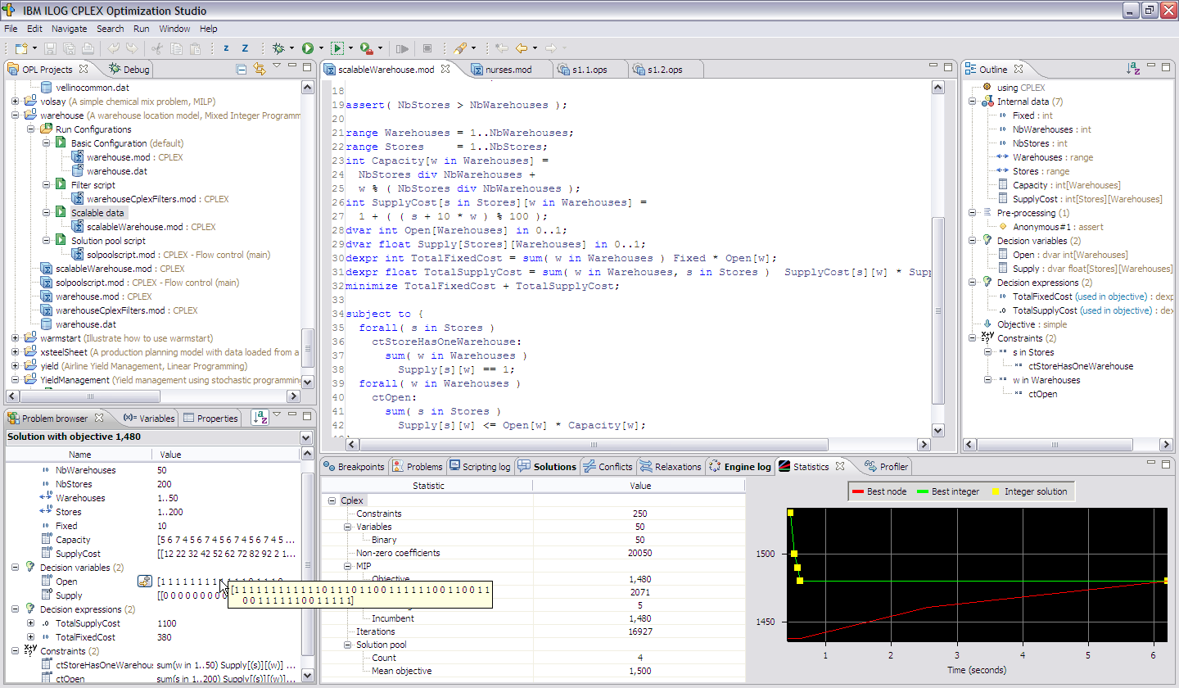
The structure of the IDE
Project navigator
Model/script code editor
Problem outline
Rapidly develop optimization models
Problem browsers
Inspector/output tabs for solution/conflict/profiler/etc
Notes:
Here you can see the IDE, with all the views. I will refer to these views when it comes to optimize for performance in the IDE

Slide 25


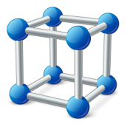
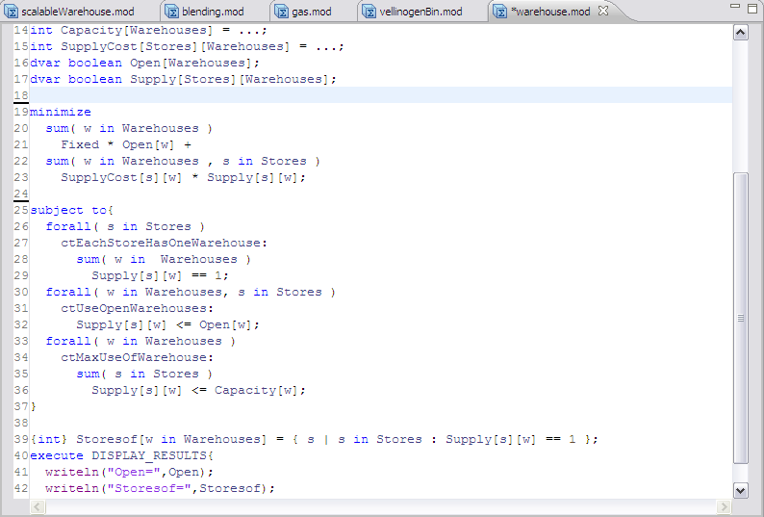
An Example of a Model
Data initialization
Decision Variables
Objective Function
Constraints
Post-processing
Notes:
This is an example of an optimization model written in the Optimization Programming Language (OPL). You can clearly see the 3 model constructs we talked about earlier (i.e., Variables, Objective, Constraints) as well as a Data Initialization and a Post-Processing block.
This model decides which warehouses to open out of a set of alternatives and then decides which stores to supply from the open warehouses, while minimizing the cost of opening warehouses and the cost of transporting goods from an open warehouse to a store.
It is easy to see that OPL is not as rigorous as a proper coding language, it is more of a high-level scripting language that is easily readable.
For example, the objective function box shows that the objective function is a minimization function that is made up of two summations, one counts the cost (i.e,. “Fixed”) of opening warehouses (i.e., “Open[w]”) and the other is the transportation cost (i.e., “SupplyCost[s][w]”) between warehouses and stores (i.e., ”Supply[s][w]”).
Another example, from the first constraint in the “constraints” box we can see that the model refers to each store (i.e,. “forall (s in Stores)”). The next line “ctEachStoreHasOneWarehouse:” is a label and is optional. The following two lines effectively say that a store should be reached by exactly one warehouse.
There are dozens of examples that come with the distribution and several are discussed in the documentation. From the IDE one can navigate to File > New > Example… and open a wizard to access the examples by different features, i.e., industry, complexity etc.

Slide 26
A More Complex Example (Supply Chain Network Design)
Input Data
Locations of Stores
Potential locations of warehouses
Transportation cost to deliver a truckload from each warehouse to each store
Number of truckloads to deliver to each store per day
Maximum Number of truckloads that a warehouse could deliver per day
Fixed cost to build each warehouse
Decision Variables
Binary variable to indicate whether to open a particular warehouse
Binary variable to indicate whether a particular store should be assigned to a particular warehouse
Constraints
For each warehouse
Sum of truckloads for all stores assigned to that warehouse is less than or equal to the warehouse capacity
For each store
Each store must be assigned to at least one warehouse, and that warehouse must be open
Objective Function
Minimize fixed cost of opening warehouses, plus transportation costs of delivery to all stores
Problem Size can get large
4000 stores, 100 potential warehouse locations, is already over 400,000 variables!
Dependent upon additional complexities, problem can be solved in a few minutes

Slide 27
To learn more about CPLEX and Decision Optimization, check out:
PPT: 5 things what you need to know about (math) optimization
DTE Video: Introduction—IBM ILOG CPLEX Optimization Studio
DTE Tutorial: Optimization Modeling with IBM ILOG CPLEX Optimization Studio
DTE Video: Key Features and Capabilities: IBM ILOG CPLEX Optimization Studio
WEB: IBM ILOG CPLEX Optimization Studio
DTE: IBM ILOG CPLEX Optimization Studio -Includes: Product Tour, Demos, Hands on Labs and more.
Documentation: Knowledge Center
System Requirements: IBM ILOG CPLEX Optimization Studio
Download: How do I download CPLEX Optimization Studio?

